Slide 1
Pong AI by GA
Presented by
Allahverdyan Alexander
Martemyanov Alexey
Dolgintseva Elizaveta

Slide 2
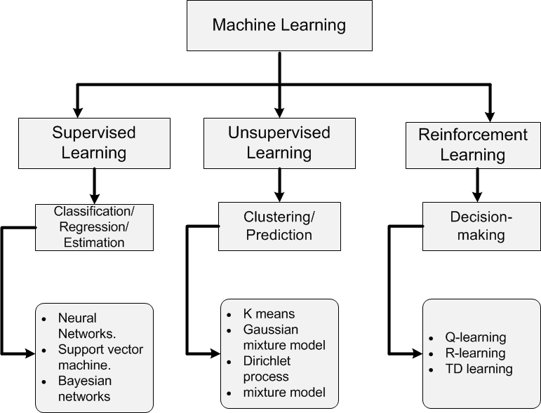
Introduction:
Neuroweb Learning to play game “Pong”, RL
GA

Slide 3
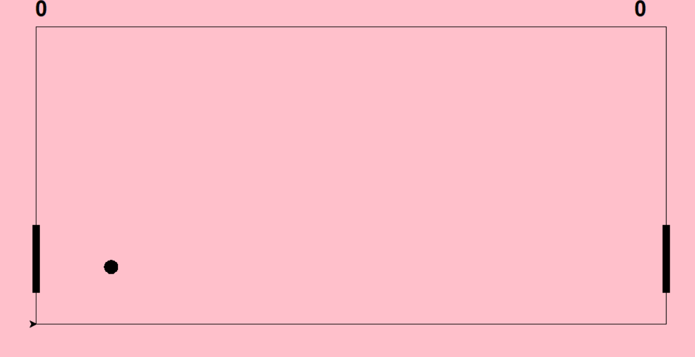

Slide 4
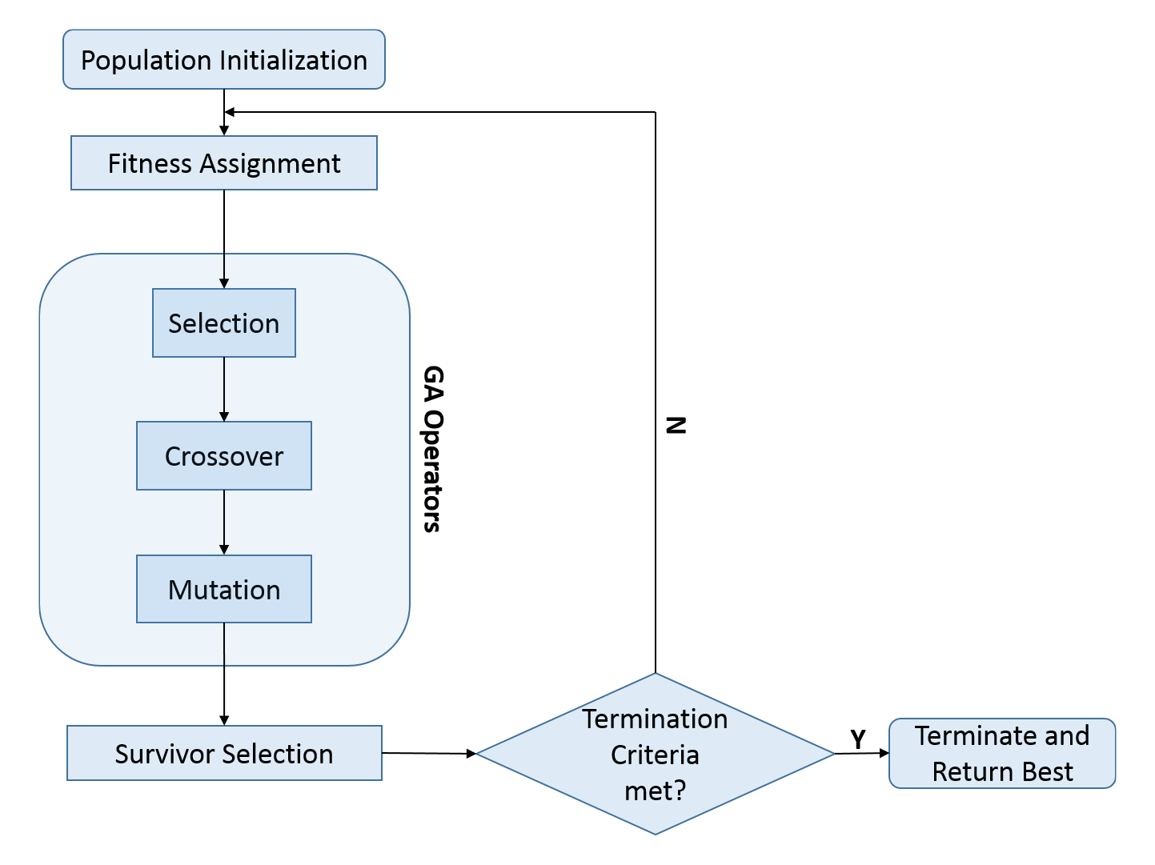
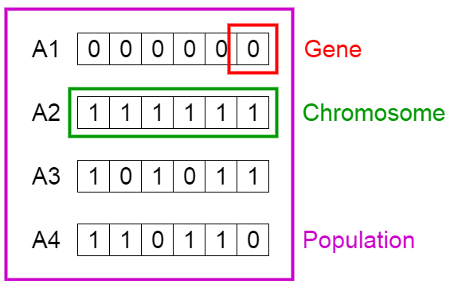
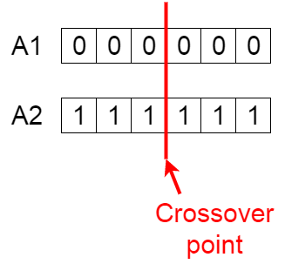
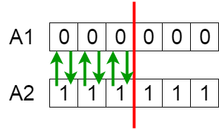
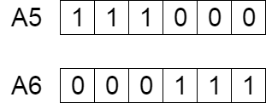
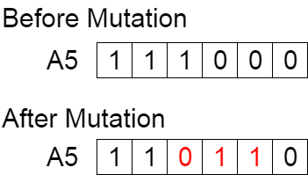
Genetic Algorithms
A genetic algorithm is a search heuristic that is inspired by the process of natural selection. Part of a series on the Evolutionary algorithm
Initial population
Fitness function
Crossover:
Selection
Mutation
Mutation:
Notes:
•A genetic algorithm is a search heuristic that is inspired by the process of natural selection where the fittest individuals are selected for reproduction in order to produce offspring of the next generation.
Genetic algorithms are commonly used to generate high-quality solutions to optimization and search problems by relying on biologically inspired operators such as mutation, crossover and selection
Five phases are considered in a genetic algorithm.
Initial population
Fitness function
Selection
Crossover
Mutation
Termination
The algorithm terminates if the population has converged (does not produce offspring which are significantly different from the previous generation). Then it is said that the genetic algorithm has provided a set of solutions to our problem.

Slide 5
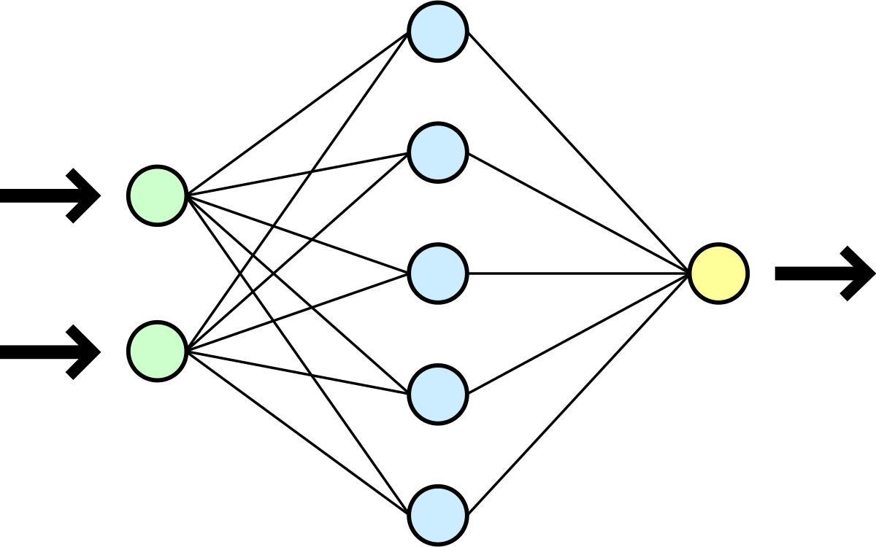
NeuroNet
Genetic Algorithm
1vs1 (to 2 score)
3 neural network layers ( 8, 10, 3 )
PyTorch

Slide 6
20 generations

Slide 7
